Slide 1


Rick Scott
Governor
Barbara Palmer
APD Director

Slide 2
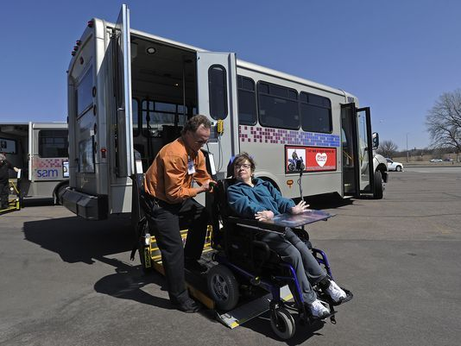
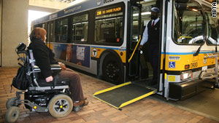
APD Customers and Transportation Presenter: Kent Carroll Transportation Coordinator August 2, 2017

Slide 3
TOPICS
OVERVIEW
KEY TERMS
SERVICE DELIVERY
SERVICE COSTS
SERVICE FUNDING
CHALLENGES
SOLUTIONS

Slide 4
OVERVIEW
Serving Floridians
WITH DEVELOPMENTAL DISABILITIES
The APD works in partnership with local communities and private providers to assist people who have developmental disabilities and their families. APD also provides assistance in identifying the needs of people with developmental disabilities for supports and services.
The agency serves more than 50,000 Floridians with the following disabilities:
People severely impaired by Autism
Cerebral palsy
Spina bifida
Intellectual disabilities
Down syndrome
Prader-Willi syndrome
Phelan-McDermid syndrome
Children age 3-5 who are at a high risk of a developmental disability

Slide 5
OVERVIEW CONT.
As of the end of July 2017, 34,095 customers are served on the waiver; 20,707 customers are on the waiting list.
The factors that affect enrollment include:
Funding availability
Legislative requirements
People in crisis have first priority
Children in the Child Welfare System are given second priority
Enrollment of waiting list customers are due in part to specific appropriations since FY 2013-14 General Appropriations Act (GAA).

Slide 6
KEY TERMS
Purchasing Agencies are state agencies, such as APD and AHCA, involved in purchasing trips for their customers and/or the transportation disadvantaged.
Alternative Transportation Providers are private for-profit or private non-profit entities that provide equivalent transportation services for the transportation disadvantaged population outside of the coordinated transportation system, such as, group homes, adult day programs, etc.
Waiver transportation is transportation to and from the customer’s home and community-based waiver services when such services cannot be accessed through natural or unpaid supports.

Slide 7



SERVICE DELIVERY
Customers receive individualized budgets based on an allocation formula or algorithm.
Customers choose transportation and other service providers based on their health and safety needs.
Waiver transportation providers must have valid service authorization prior to beginning services and billing via the Medicaid fiscal agent.
Transportation providers are reimbursed by month, mile, or trip.
All transportation rates are negotiated.

Slide 8
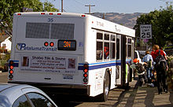

Who can provide waiver transportation?
Community Transportation Coordinators
Community fixed-route/paratransit
Group Homes/Residential Facilities
Adult Day Programs
Private for-profit and not-for-profit entities
Limited Transportation Providers

Slide 9
SERVICE COSTS
Waiver funded transportation expenditures for the last 3 fiscal years.
Fiscal Year | Customers | Expenditures
FY 13-14 | 8,214 | $22,442,675.55
FY 14-15 | 9,082 | $25,431,744.48
FY 15-16 | 9,646 | $28,810,876.32
APD has averaged an annual 13% increase in waiver transportation expenditures for the last 3 fiscal years.
Nearly 10,000 customers receiving transportation via the waiver.

Slide 10
SERVICE FUNDING
Agency Funding Overview | FY 2017-2018 Appropriations
Program | FTE | General Revenue | Federal and State Trust Funds | Total
Home & Community Services | 428.0 | 442,914,145 | 689,485,215 | 1,132,399,360
Program Management & Compliance | 161.0 | 15,345,302 | 12,973,375 | 28,318,677
Developmental Disability Centers - Civil Program | 1609.0 | 38,549,216 | 58,050,606 | 96,599,822
Develomental Disability Centers - Forensic Program | 504.5 | 28,763,492 |  | 28,763,492
Total | 2,702.50 | 525,572,155 | 760,509,196 | 1,286,081,351
Fund Type: Federal and State Trust Funds - 59.1%; General Revenue - 40.8%;
Program Percentages: HCBS – 88.0%; Program Mgt. & Compliance – 2.2%; Development Disability Centers – 9.7%

Slide 11

CHALLENGES
Multiple funding sources
Complicated transportation system
Limited mobility options and providers
Limited inter-county and inter-county connections
Funding

Slide 12

SOLUTIONS
Mobility Management
Single Point of Contact
Education
Regional Voucher Programs
Increased Mobility Options and Scheduling Flexibility
Provider Development and Incentivization
Innovative Funding
Business Partnerships

